Slide 1
Optimizing Sales & Customer Insights
Student Name: Ahmed Tawfeeq P S Course 6 : Data Analysis using Tableau
Batch Code: DA464S46
Project Guide: Komilla Bhatia

Slide 2
Problem Statement
Analyze customer, sales, and employee data to identify trends, optimize performance, and support strategic decisions.

Slide 3
Dataset Overview
Datasource: Sales Data
Key Metrics: Order number, Quantity Ordered, Price each, Sales, Order date, Status.

Slide 4
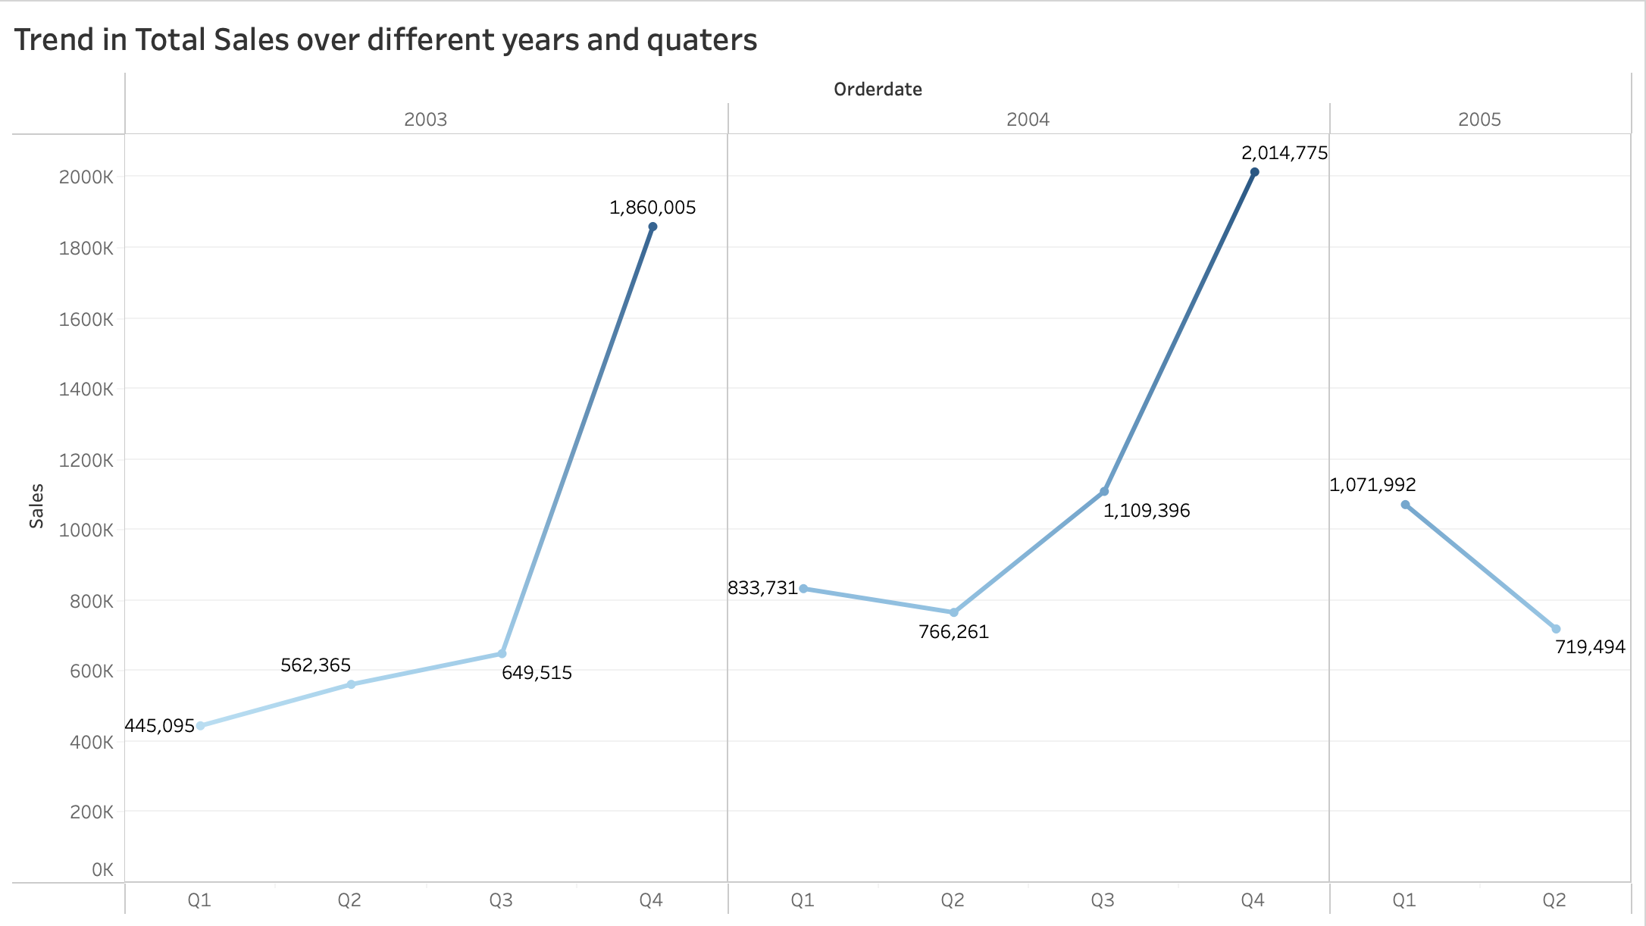
Trend in total sales over years and Quarters

Slide 5
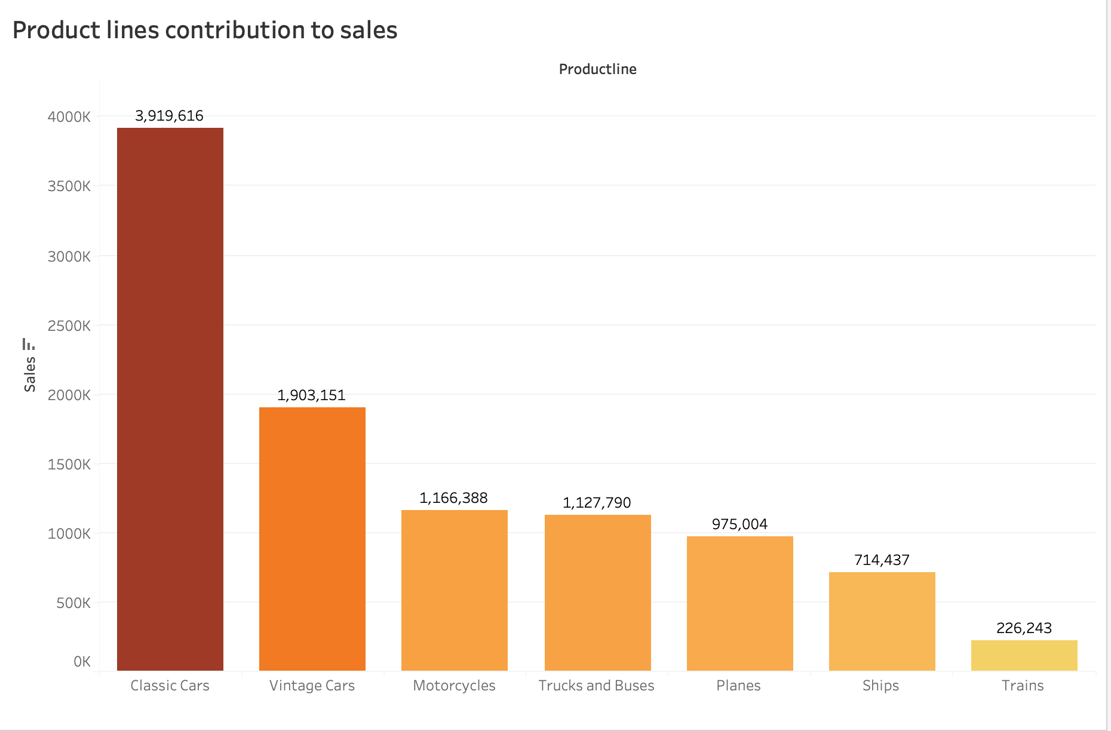
Sales generated from product lines

Slide 6
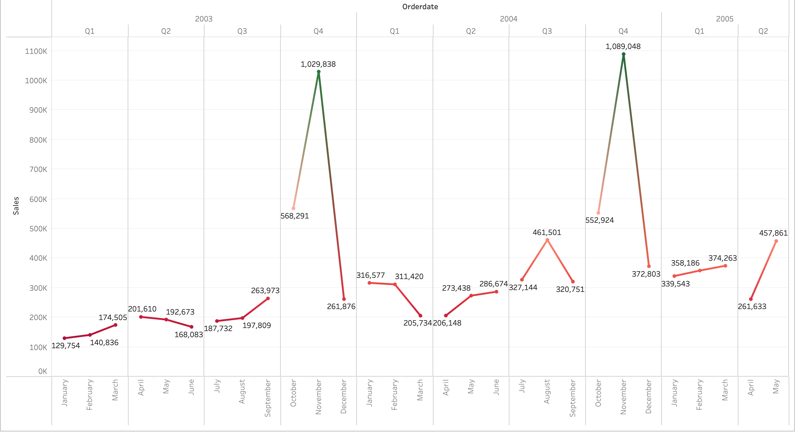
Seasonal Patterns on Sales

Slide 7
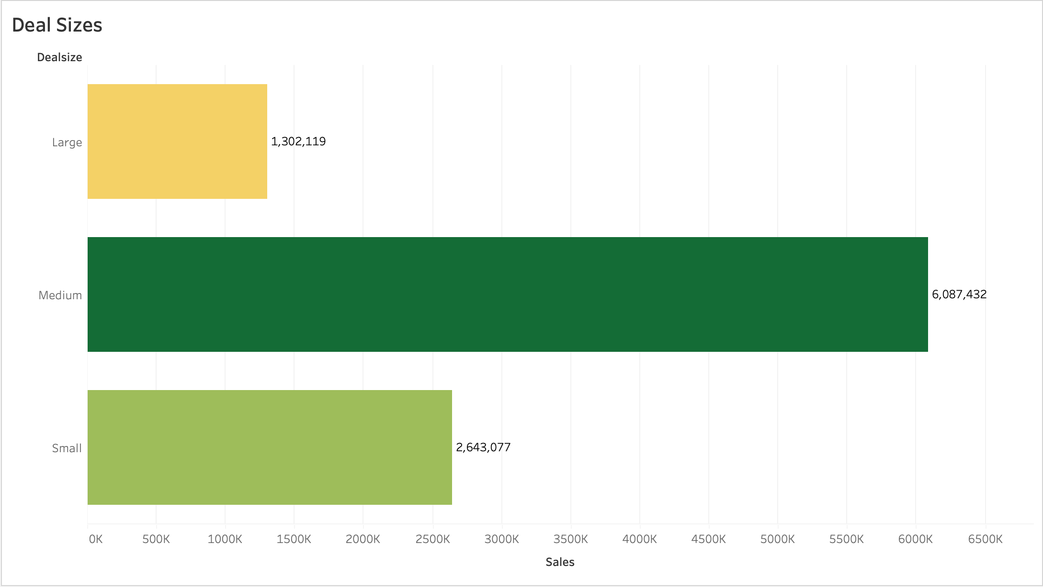
Total Sales on different Deal Sizes

Slide 8
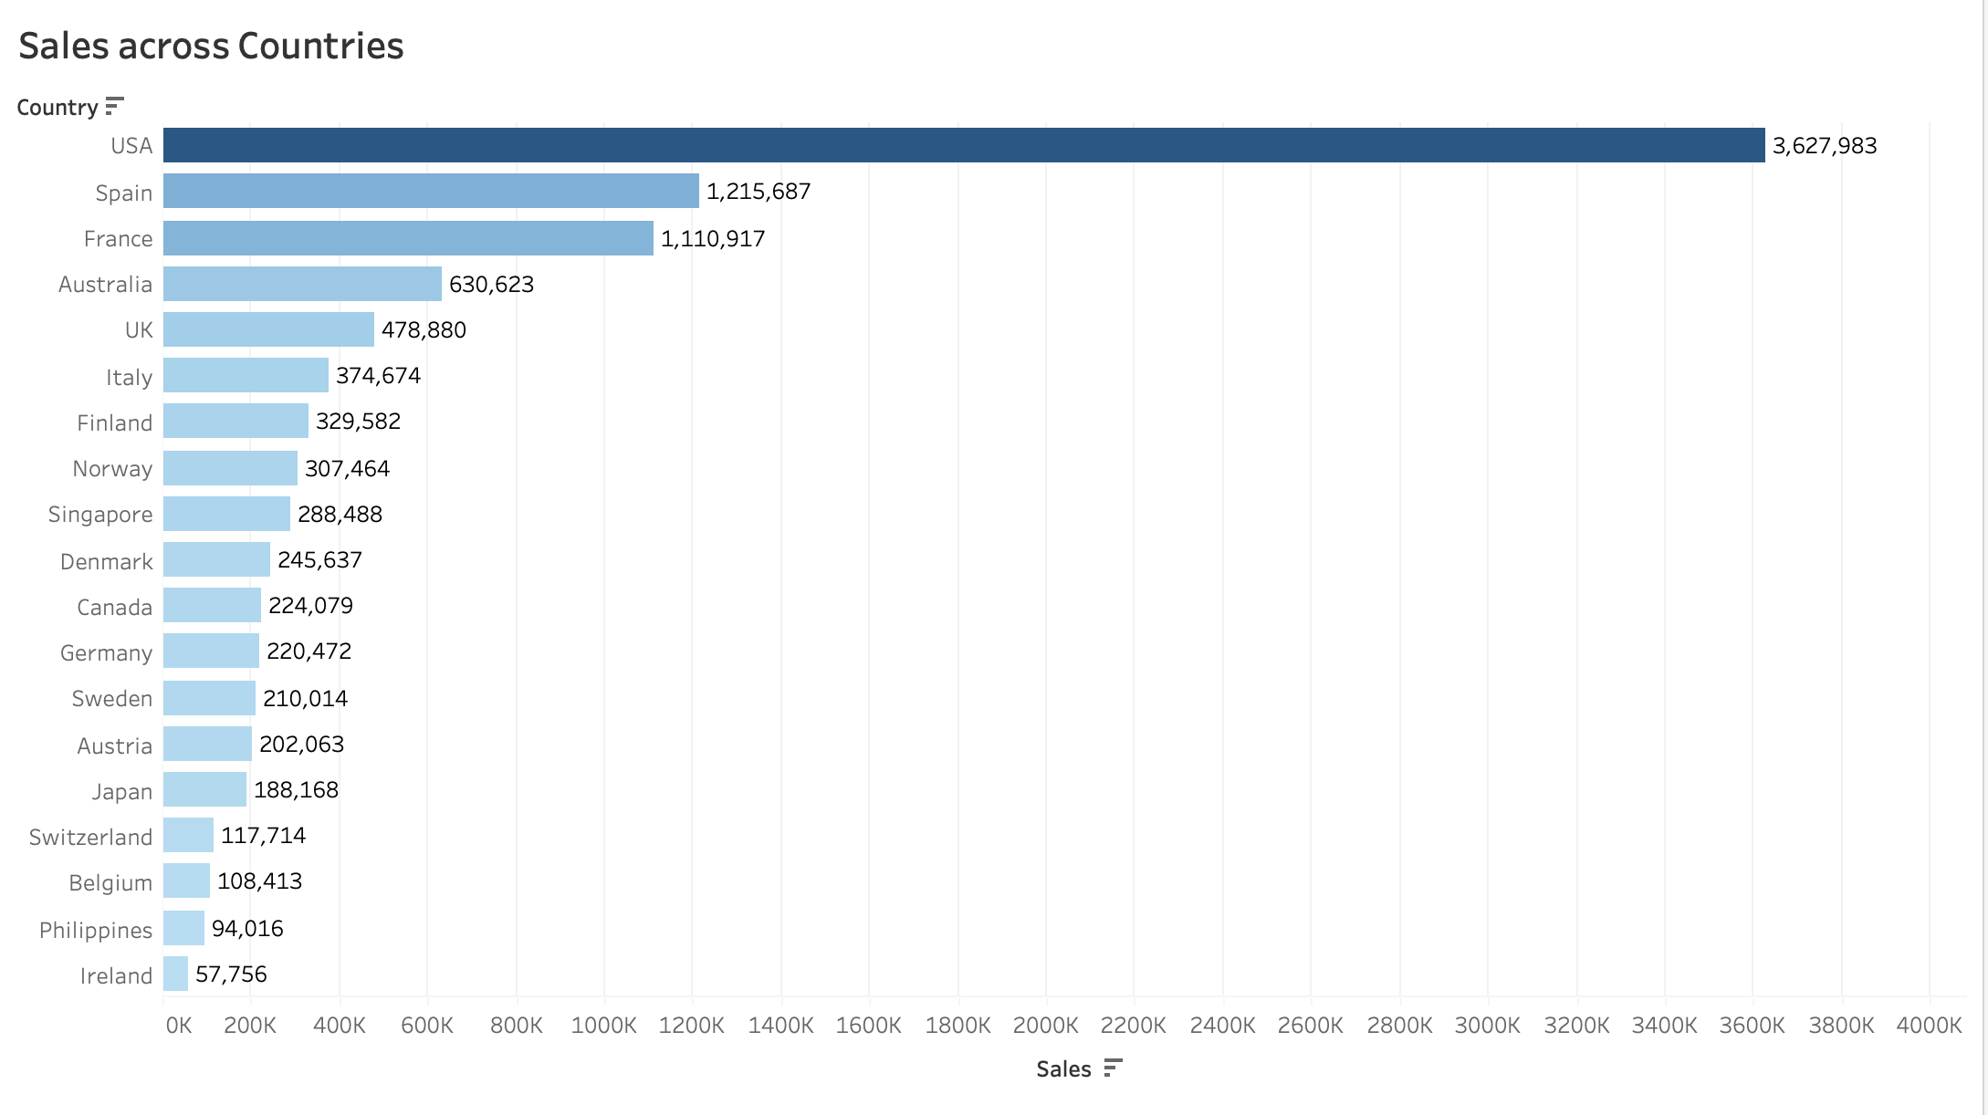
Sales Distribution across countries

Slide 9
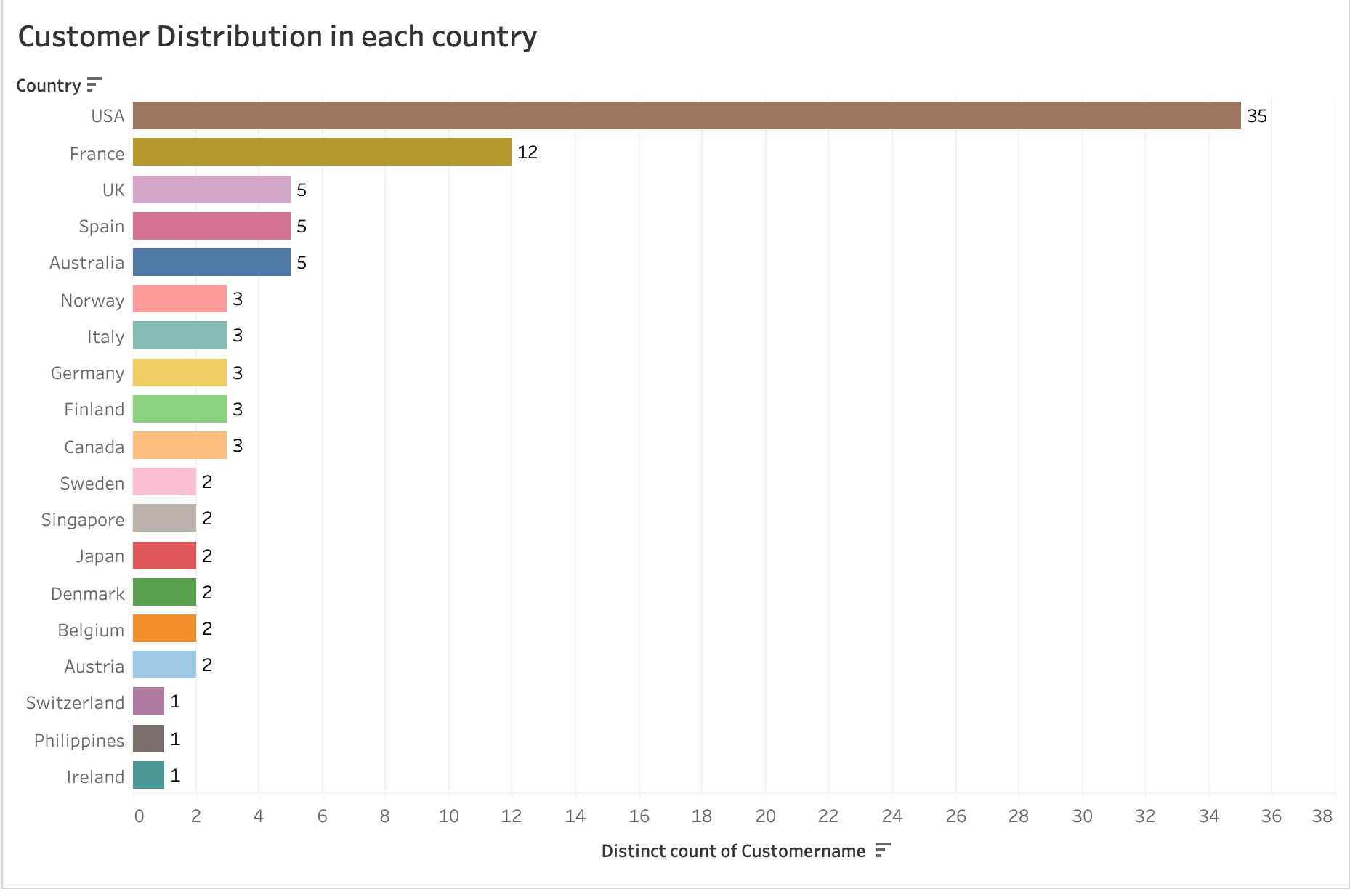
Customer distribution in each countries

Slide 10
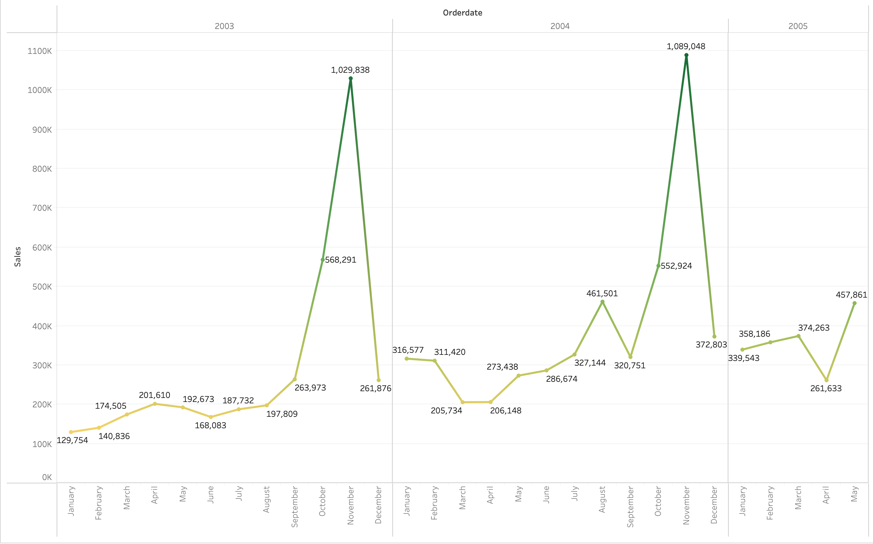
Evolution of sales over the time

Slide 11
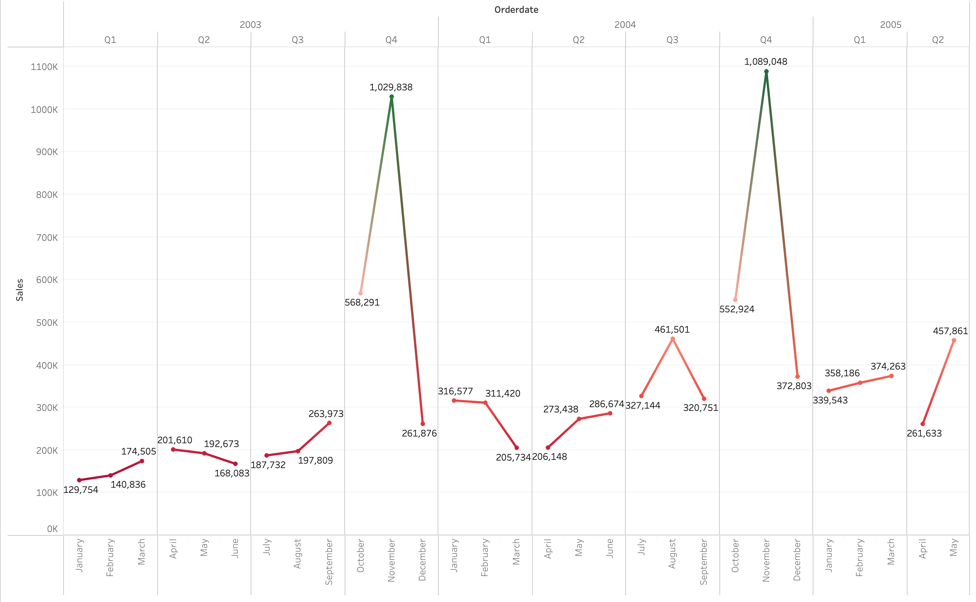
Seasonality in Sales data

Slide 12
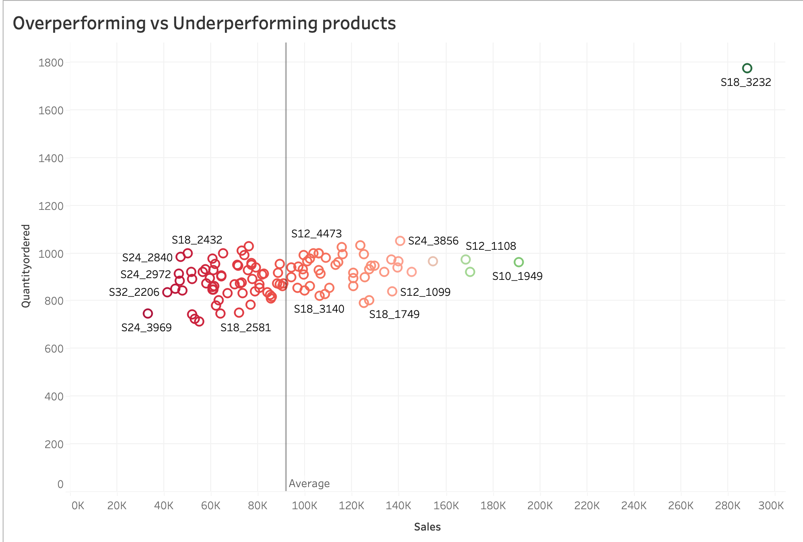
Over performing & Under Performing Products

Slide 13
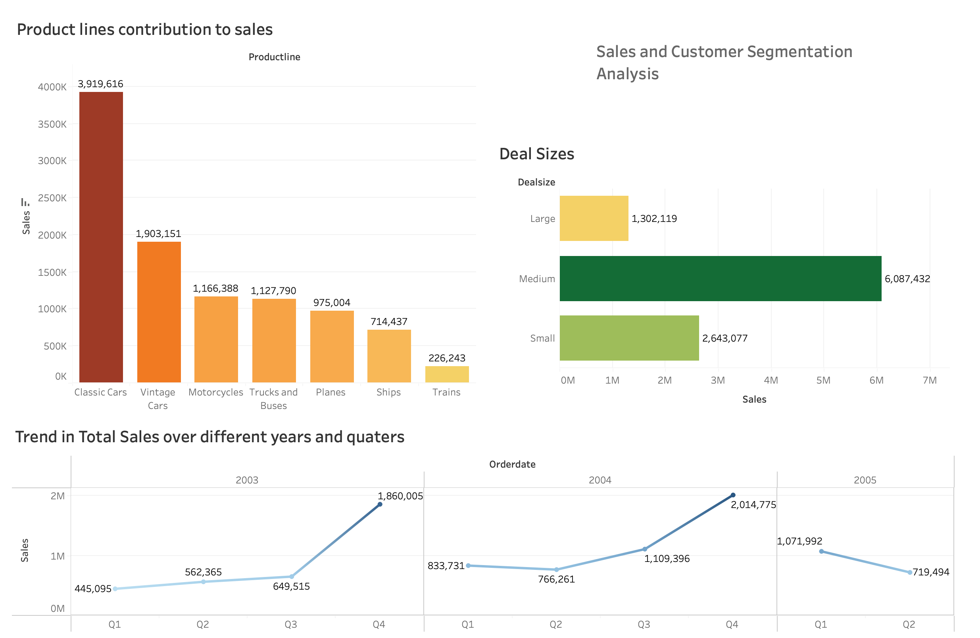
Sales & Customer Demogrphics Dashboard

Slide 14
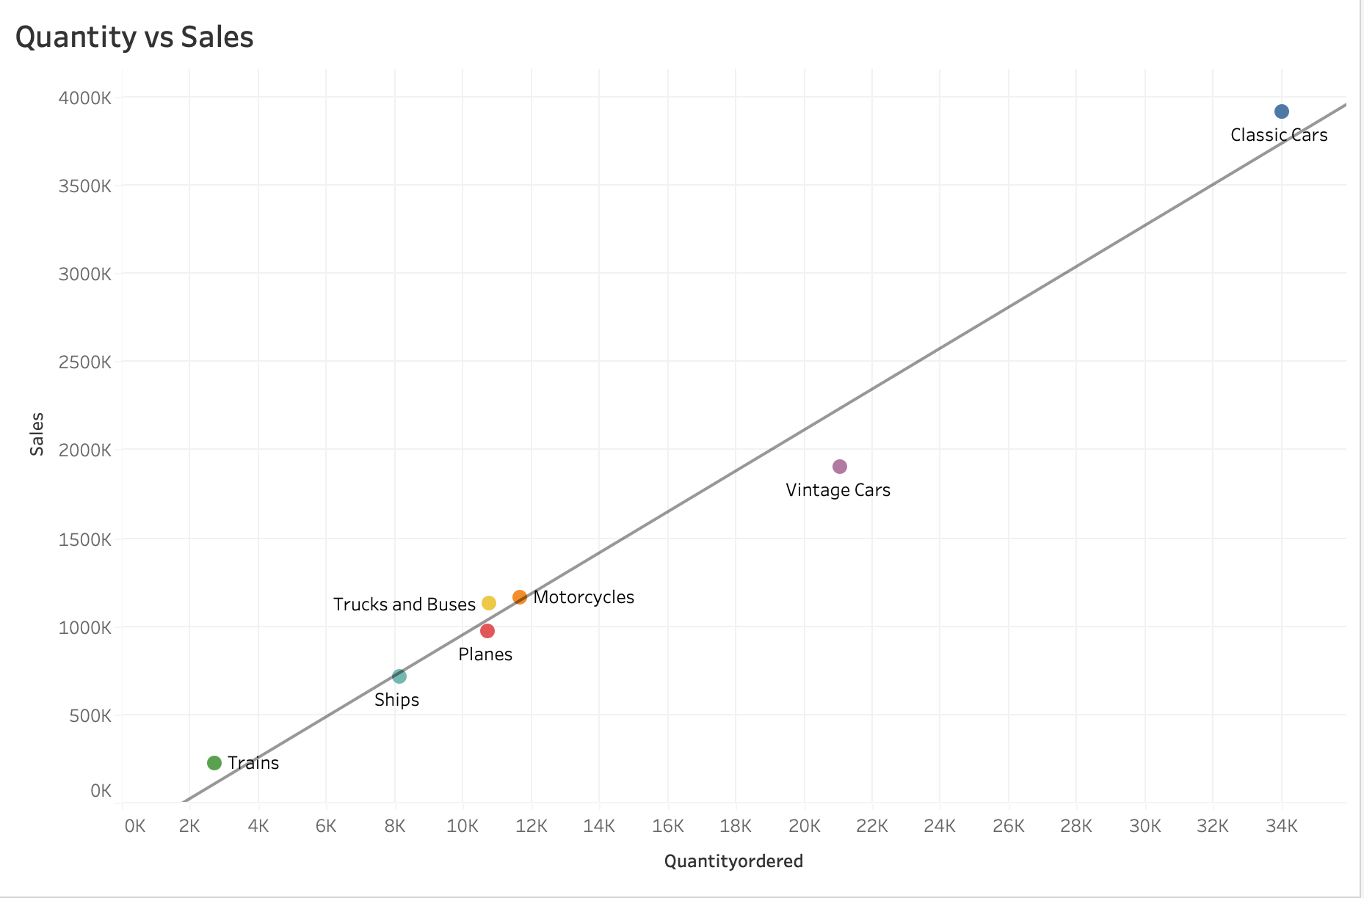
Relationship Between Quantity & Sales

Slide 15
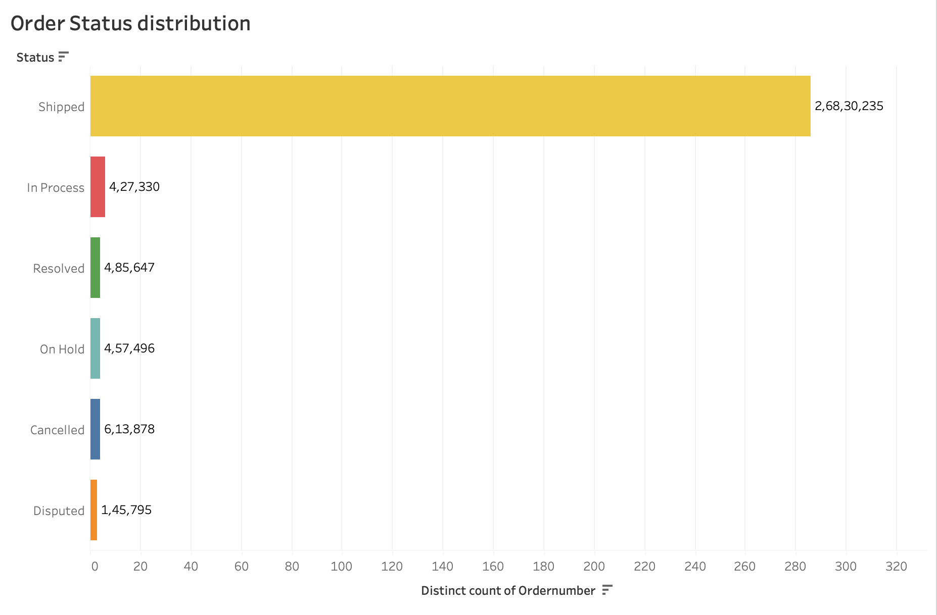
Distribution of Order Status

Slide 16
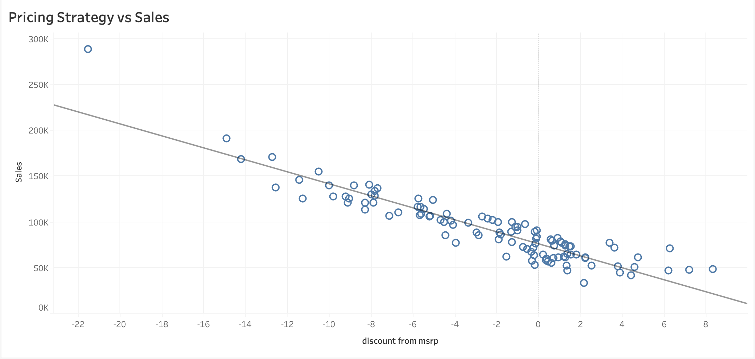
Relationship between Pricing Strategy & Sales

Slide 17
Summary
High-value customers identified
Expansion opportunities based on geographic analysis
Sales rep performance optimization
Product line sales trends

Slide 18
Summary
Prioritize customer retention strategies
Expand sales efforts in high-credit-limit countries
Optimize sales rep structure based on performance
Re-engage inactive customers with targeted marketing

Slide 19
Summary
Short-term: Improve customer engagement
Mid-term: Optimize sales team strategy
Long-term: Expand into high-potential markets

Slide 20
Conclusion
Data-driven decisions can improve business performance
Tableau analysis provides key insights for growth strategies
Implementation of recommendations will drive success

